Slide 2
Docker installation
Download the installation file for MAC-OSX.
Download the installation file for Windows.

Slide 3
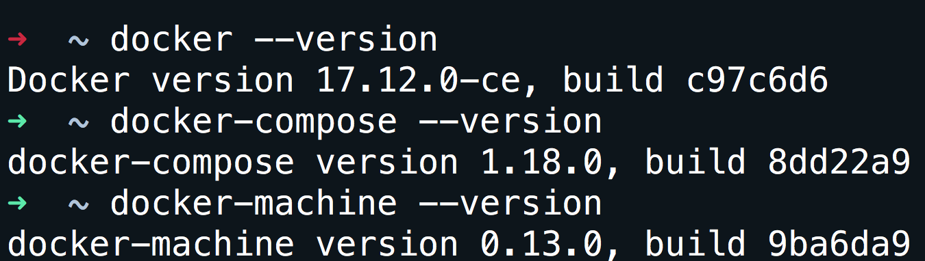
Verify installation
docker --version

Slide 4
Don’t want to install that is ok.
Open your browser and go to: https://labs.play-with-docker.com/

Slide 5
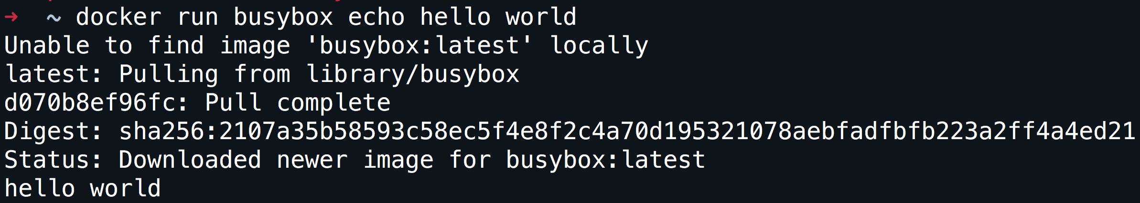
Run your first container
docker run busybox echo hello world

Slide 6
What did we just do
We download the smallest and simplest image from a repo.
We executed the command hello world.

Slide 7
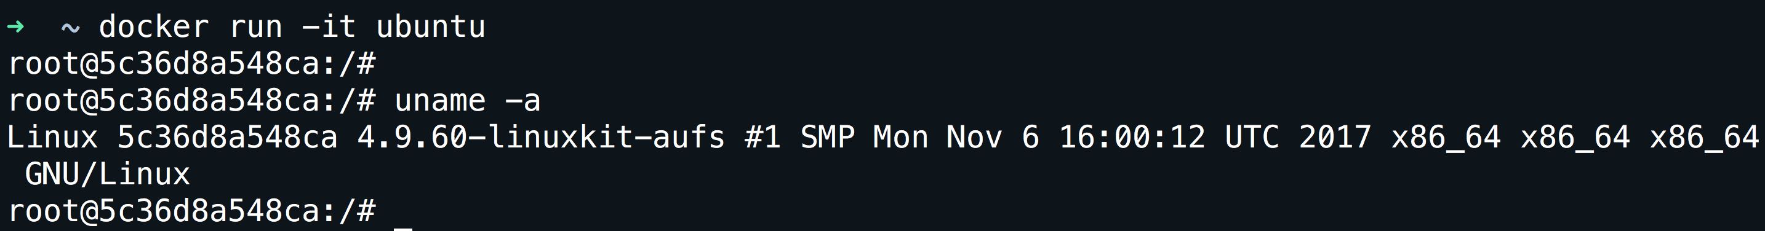
A more useful container
docker run -it ubuntu
-it is shorthand for -i -t.
-i tells Docker to connect us to the container's stdin.
-t tells Docker that we want a pseudo-terminal.

Slide 8
A few concepts
Images.
Volumes.
Network.
Containers.

Slide 9
Images
What is an image.
What is a layer.
The various image namespaces.
How to search and download images.
Image tags and when to use them.

Slide 10
What is an image
Image = files + metadata
Images are made of layers, conceptually stacked on top of each other.
Each layer can add, change, and remove files and/or metadata.
Images can share layers to optimize disk usage, transfer times, and memory use.
The images are a read-only filesystem.

Slide 11
Object-oriented programming
Images are conceptually similar to classes.
Layers are conceptually similar to inheritance.
Containers are conceptually similar to instances.

Slide 12
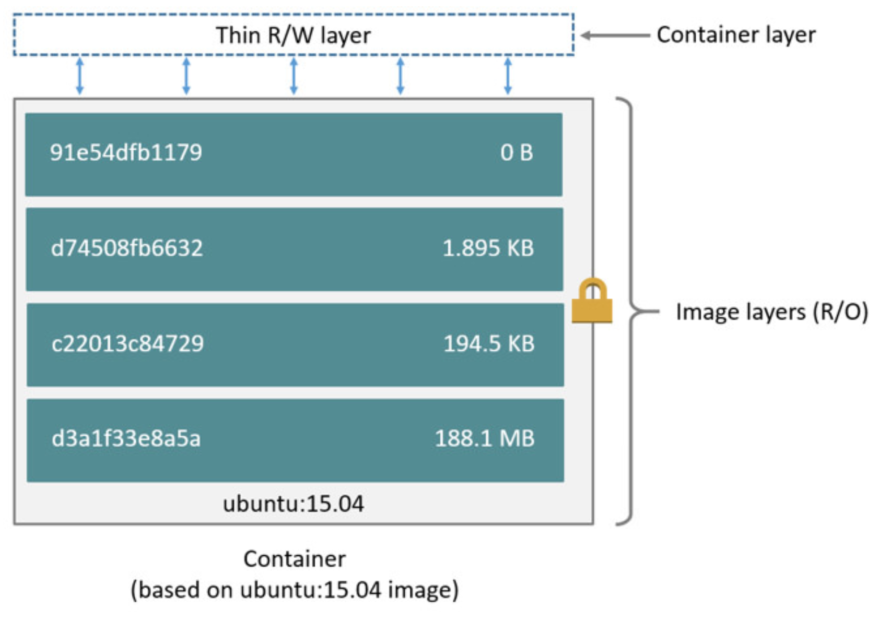
How an image looks like

Slide 13
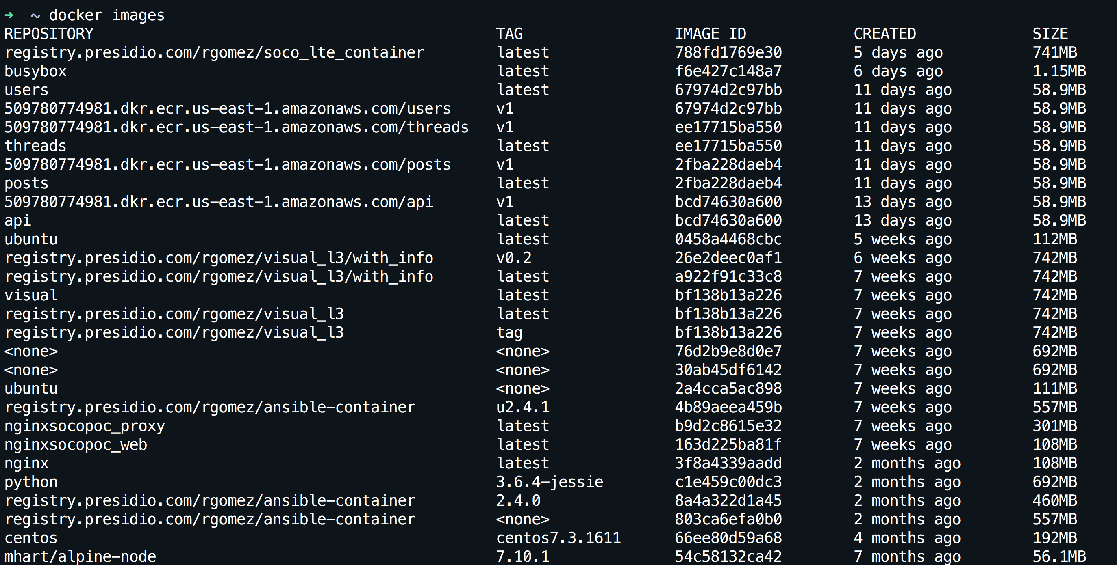
How can I see my images
docker images

Slide 14
Wait a minute…The image is read-only???!!!
We don't.
We create a new container from that image.
Then we make changes to that container.
When we are satisfied with those changes, we transform them into a new layer.
A new image is created by stacking the new layer on top of the old image.

Slide 15
How do we update an image
docker commit
Saves all the changes made to a container into a new layer.
Creates a new image (effectively a copy of the container).
docker build
Performs a repeatable build sequence.
This is the preferred method!

Slide 16
Dockerfile
vi dockerfile
Inside the file copy:
FROM ubuntu
RUN apt-get update
RUN apt-get install figlet
Save the file
docker build -t figlet .
docker images
docker run -ti figlet figlet HELLO

